Slide 1
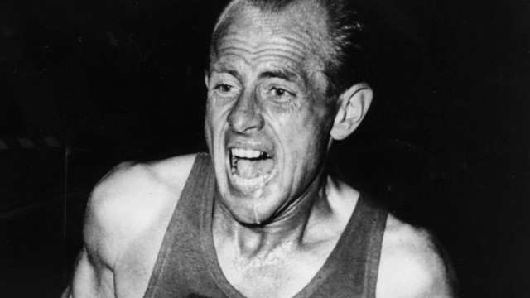
Emil zatopek – 5,000m, 10,000m & marathon gold in 1952

Slide 2
Philippians 3v10-4v1
I want to know Christ and the power of his resurrection and the fellowship of sharing in his sufferings, becoming like him in his death, ¹¹ and so, somehow, to attain to the resurrection from the dead. ¹² Not that I have already obtained all this, or have already been made perfect, but I press on to take hold of that for which Christ Jesus took hold of me. ¹³Brothers, I do not consider myself yet to have taken hold of it. But one thing I do: forgetting what is behind and straining towards what is ahead, ¹⁴ I press on towards the goal to win the prize for which God has called me heavenwards in Christ Jesus.
Who are the runners? v12, 16, 20
Who gives out the medals? v14
Where does the medal ceremony happen? v14

Slide 3
Why is Paul running? V10-13
Notice how Paul runs? And we are called too v17
Singled minded – v13 “this one thing I do”
Looking ahead – v13 “forgetting what is behind”
With determination – v13-14 “forgetting what is behind and straining towards what is ahead I press on towards the goal to win the prize for which God has called me heavenwards in Christ Jesus”

Slide 4
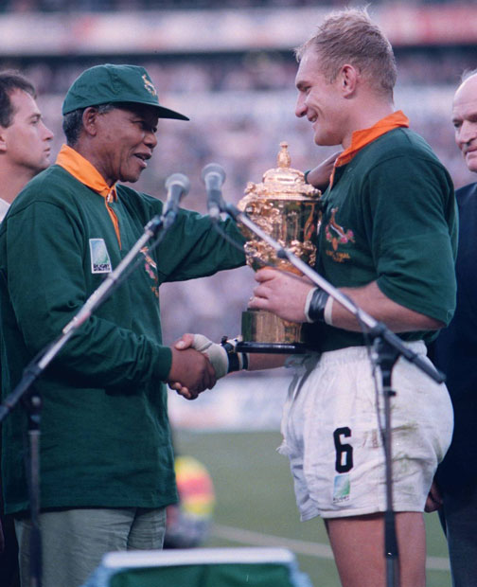
Well done good and faithful servant

Slide 5
Why is Paul running? V10-13
Notice how Paul run? And we are called too v17
Singled minded – v13 “this one thing I do”
Looking ahead – v13 “forgetting what is behind”
With determination – v13-14 “forgetting what is behind and straining towards what is ahead I press on towards the goal to win the prize for which God has called me heavenwards in Christ Jesus”
Avoiding obstacles – v18-19 “many live as enemies of the cross”

Slide 6
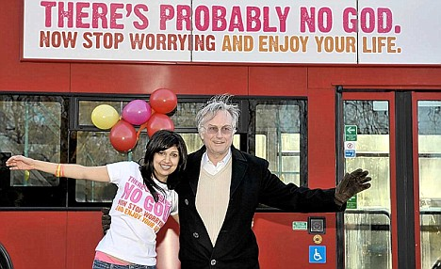
Their god is their stomach ..their mind is on earthly things – v19

Slide 7
Running is tiring – “I was unable to walk for a whole week after that, so much did the race take out of me” Emil Zatopek
Paul finishes with a positive
v20-4v1 “But our citizenship is in heaven. And we eagerly await a Saviour from there, the Lord Jesus Christ, ²¹ who, by the power that enables him to bring everything under his control, will transform our lowly bodies so that they will be like his glorious body.
^{4v1} Therefore, my brothers, you whom I love and long for, my joy and crown, stand firm in the Lord in this way, dear friends!”

